Slide 1
Modelováni a simulace
Simulátor modelů populace
T.Hrůza, V.Roun

Slide 2
Malthusův model
function [ pole ] = fceMalthus( x0, r, t)
pole=zeros(1,t);
pole(1)=x0;
for i=2: 1: t
pole(i)=x0*exp(r*i);
if pole(1)<=0
pole(1)=0;
end
end

Slide 3
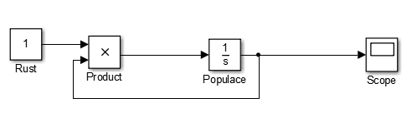
Malthusův model SIMULINK

Slide 4
Malthusův model UNIT TEST
disp('TEST Malthusuv model')
x0=10;
r=2;
t=10;
mal=fceMalthus(x0,r,t);
if mal(t)==x0*exp(r*t)
disp('Malthus OK')
KSUM=KSUM-1;
else
disp('Maltus CHYBA')
end

Slide 5
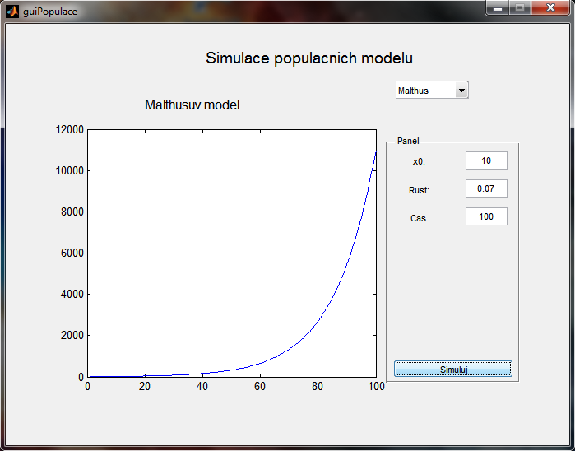
Malthusův model

Slide 6
Logistický model
function [ pole ] = fceLogistic( x0, r, t, K )
kapacita=K;
pole=zeros(1,t);
pole(1)=x0;
for i=2: 1: t
pole(i)=pole(i-1)+pole(i-1)*r*(1-(pole(i-1)/kapacita));
if pole(1)<=0
pole(1)=0;
end
end

Slide 7
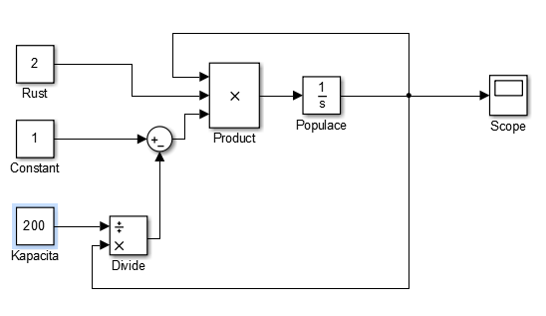
Logistický model SIMULINK

Slide 8
Logistický model UNIT TEST
disp('TEST Logisticky model')
x0=10;
r=2;
t=10;
K=100;
logic=fceLogistic(x0,r,t,K);
if int32(logic(10))==109
disp('Logisticky model OK')
KSUM=KSUM-1;
else
disp('Logisticky model CHYBA')
end

Slide 9
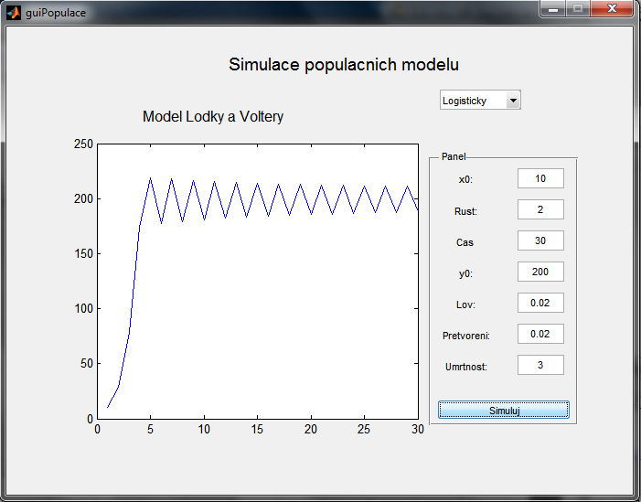
Logistický model

Slide 10
Dravec-kořist model
function [ pole ] = fceLodkyVoltery( x0, y0, t, rustx, loveni, pretvoreni, umrtnost)
pole=zeros(2,t);
pole(1,1)=x0;
pole(2,1)=y0;
for i=2: 1: t-1
pole(1,i+1)=pole(1,i)+(rustx*pole(1,i)-(loveni*pole(1,i)*pole(2,i)));
if pole(1,i+1)<1
pole(1,i+1)=1;
end
pole(2,i+1)=pole(1,i)+((loveni*pretvoreni*pole(1,i)*pole(2,i))-(umrtnost*pole(2,i)));
if pole(2,i+1)<1
pole(2,i+1)=1;
end
end

Slide 11
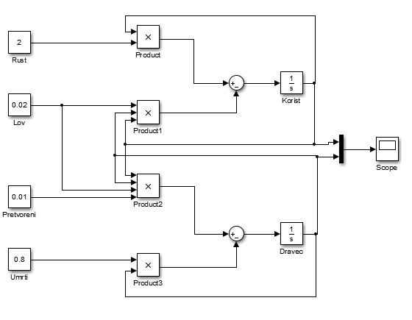
Dravec-kořist SIMULINK

Slide 12
Dravec-kořist UNIT TEST
disp('TEST model Lodky-Voltery')
x0=100;
y0=20;
t=15;
rustx=0.75;
lov=.01;
pretvoreni=.02;
umrtnost=0.2;
LaV=fceLodkyVoltery(x0,y0,t,rustx,lov,pretvoreni, umrtnost);
if int32(LaV(1,10))==41 && int32(LaV(2,10))==23
disp('test Lodky a Voltery OK')
KSUM=KSUM-1;
else
disp('test Lodky a Voltery CHYBA')
end

Slide 13
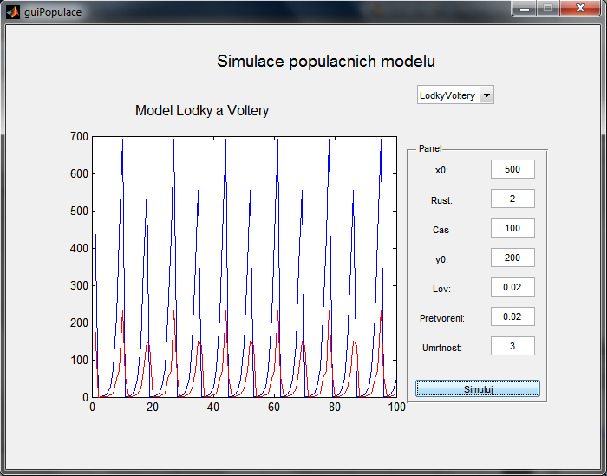
Dravec-kořist model

